Slide 1
CUA REU: Week 2
Antonio Perillo

Slide 2
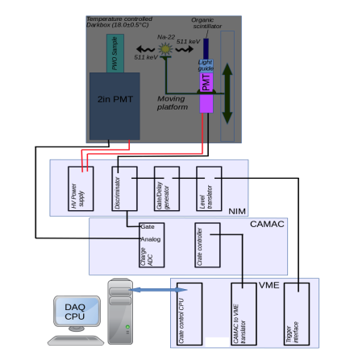
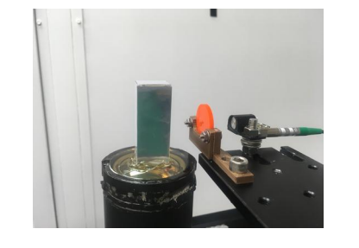
Experimentation

Slide 3
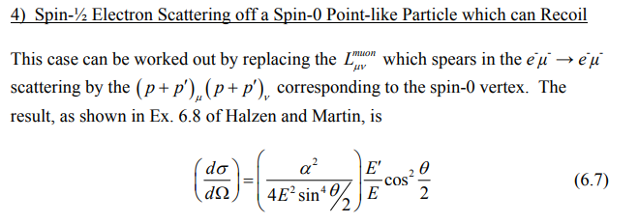
Computation

Slide 4
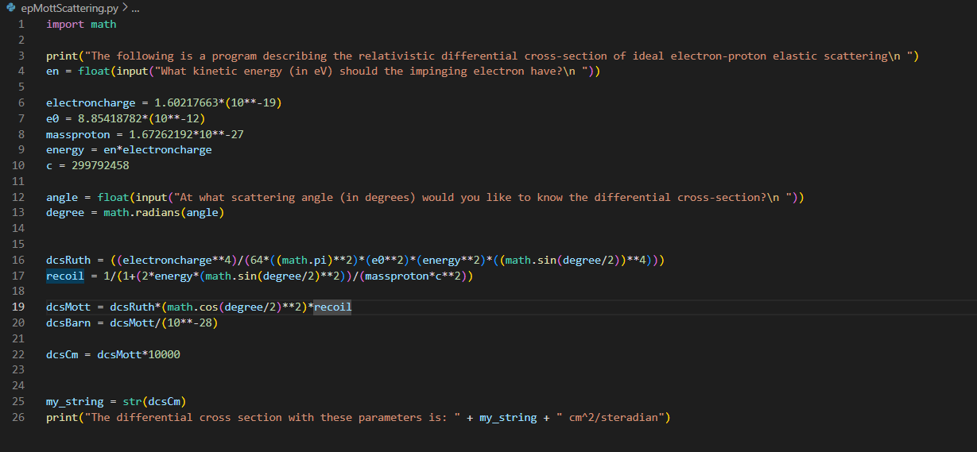
Updated Code

Slide 5
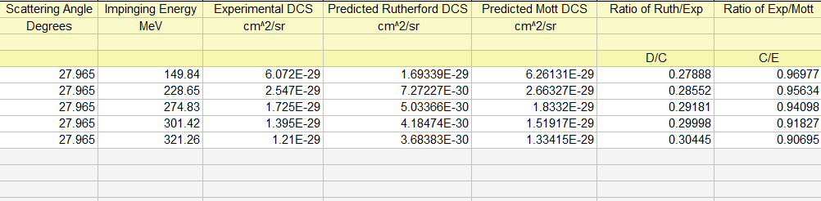
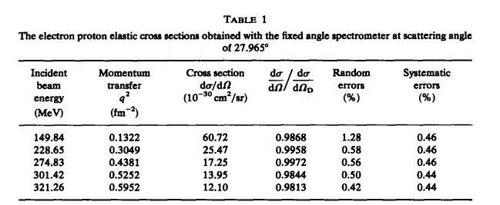
Computation Results
Above: Table summarizing the predictions of my program using Rutherford and Mott Scattering vs experimental results of low MT e+p scattering
Left: Table summarizing DCS of e+p scattering at fixed scattering angle
https://www.sciencedirect.com/science/article/pii/0375947480901049

Slide 6
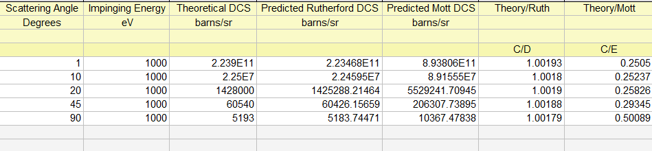
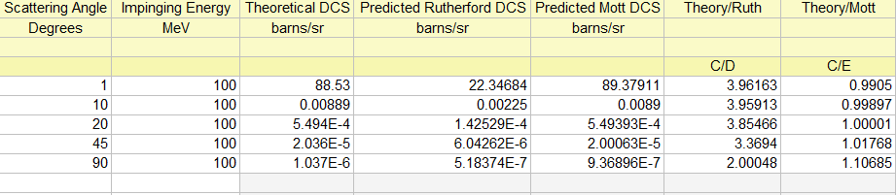
Further Results
Above: Table summarizing the efficacy of the Rutherford model at low incident energy
Below: Table summarizing the efficacy of the Mott model at high incident energy
https://digital.library.unt.edu/ark:/67531/metadc865143/m2/1/high_res_d/4067467.pdf

Slide 7
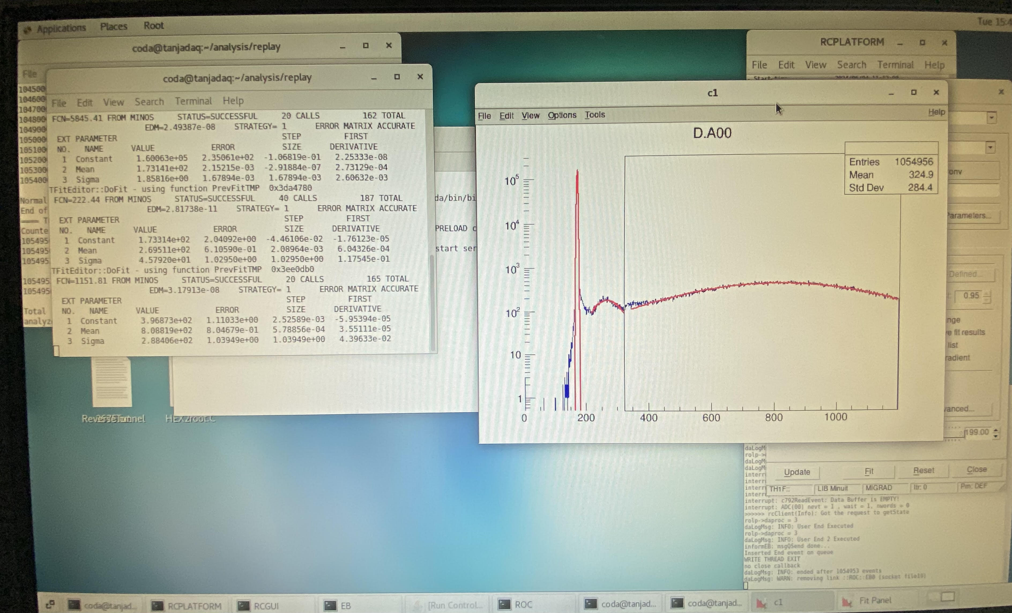
Experimental Results
Results of light yield experiment from chosen sample crystal of Week 1
Duration: 4hr 7min 7sec
Total events: 1,054,956 ± 1027
Total Light Yield:
12.91 ± 1.96 photoelectrons/MeV

Slide 8
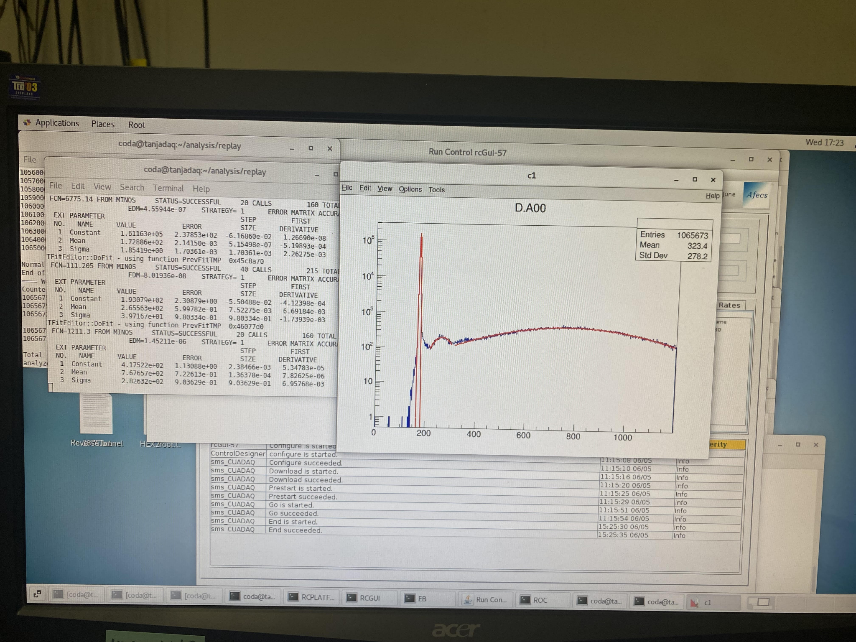
Experimental Results
Light Yield results of reference crystal scintillator:
Duration: 4hrs 9min 41sec
Total Events: 1,065,673 ± 1032
Total Light Yield:
12.56 ± 1.96 photoelectrons/MeV

